Slide 1
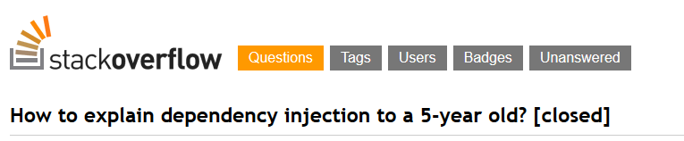
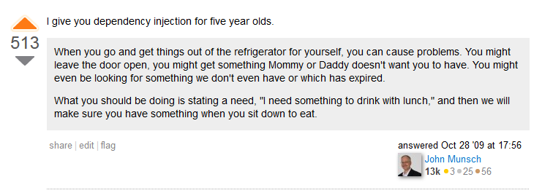
http://stackoverflow.com/questions/1638919/how-to-explain-dependency-injection-to-a-5-year-old/1638961#1638961

Slide 2

Dependency Injection, the right way
Thibaud DESODT
@tsimbalar
Notes:
Present you self

Slide 3
This talk
What it is about
Dependency Injection patterns
Benefits
Common pitfalls
What it is not about
Specific IoC/DI Container implementations
Pre-requisites
OOP
Class-based statically-typed languages
Based on examples
Notes:
Talk about Dependency Injection
Dependency Injection patterns
You may know about it under a form or another, or ay have used tools
Who has ?
You must unlearn ! Need to understand the philosophy and concepts in order to use the tools properly
It’s easy to misuse the tools and miss some benefits

Slide 4


Slide 5
Dependency Injection
What ?

Slide 6
Dependency Injection
Dependency Injection is a set of practices that allow to build loosely coupled applications

Slide 7
Dependency Injection
Dependency Injection is a set of practices that allow to build loosely coupled applications
It’s NOT :
A library
A framework
A tool
It IS :
A way of thinking
A way of designing code
General guidelines

Slide 8
Dependency Injection
Dependency Injection is a set of practices that allow to build loosely coupled applications
Small components …
Independent
Reusable
Interchangeable
… plugged together to form a bigger system
Benefits :
Small classes with single responsibility
Easier maintenance
Extensibility
Testable by definition
Notes:
Comment :
First encounter with need for loosely coupled code came from unit tests
Who write unit tests here ? Anybody who writes unit tests first ?
First encounter where you code MUST BE loosely coupled : unit tests ! Actually consume components out of the scope of the application
Tightly coupled code is hard to test or not testable at all … if it’s testable it’s not too tightly coupled

Slide 9
Loosely coupled code
Independent components
Reusable
Interchangeable
Glued together to form a bigger system
TODO: image ? Big containing application + components that do not really know each other’s internals
Ultimate goal :
Maintainability : change should impact only a module
Make the system evolve without pain
Notes:
Comment :
First encounter with need for loosely coupled code came from unit tests
Who write unit tests here ? Anybody who writes unit tests first ?
First encounter where you code MUST BE loosely coupled : unit tests ! Actually consume components out of the scope of the application
Tightly coupled code is hard to test or not testable at all … if it’s testable it’s not too tightly coupled

Slide 10
From Tightly to Loosely Coupled
Show me the code !

Slide 11
Example : Boring Banking System
User can list his accounts

Slide 12
Tightly coupled code

Slide 13
Separation of Concerns (SRP)

Slide 14
Program to an abstraction

Slide 15
Making it testable - Properties

Slide 16
Making it testable - Constructor

Slide 17
Inversion of Control

Slide 18
It’s viral !
Composition Root

Slide 19
Pure DI aka Poor Man’s DI

Slide 20
Extensibility with DI
Composability
Testability
Decorator
Late binding
Examples ?

Slide 21
DI Container
How it works / what it does

Slide 22
Service Locator – DI container misusage

Slide 23
Composition, but not only
Object creation and composition
Other important parts of DI

Slide 24
LifeTime Management

Slide 25
Interception

Slide 26
Conclusion

Slide 27
Remember

Slide 28
Going further …
Mark Seemann’s book and blog posts
Conversation about DI in aspnet vNext
SOLID

